Slide 1
Final Project Proposal
Team 11
Topic: Sentiment Analysis
Amazon Fine Food Reviews
Vaishali Lambe
Rijuta Wagh

Slide 2
About the Dataset –Amazon Food Reviews
This dataset consists of reviews of fine food from amazon https://snap.stanford.edu/data/web-FineFoods.html
The data span a period of 4 years, including ~5 million reviews up to October 2012
Reviews include product and user information, ratings, and a plaintext review

Slide 3
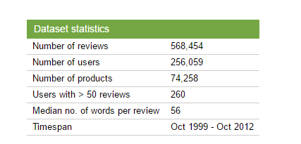
All about data!

Slide 4
Columns
ProductId - unique identifier for the product
UserId - unqiue identifier for the user
ProfileName- Name of the user
HelpfulnessNumerator - number of users who found the review helpful
HelpfulnessDenominator - number of users who indicated whether they found the review helpful
Score - rating between 1 and 5
Time - timestamp for the review
Summary - brief summary of the review
Text - text of the review

Slide 5
Our Approach
Downloading the data which is present in .gz format
It contains .txt file which we will convert into .csv
Data cleaning and pre processing: remove stopwords, punctuations, conversion of uppercase to lowercase for text processing
Data exploration activities to do some initial analysis(Python and Tableau/PowerBI)
Feature Extraction(The features, such as bag-of-words and bigrams, are compared to one another in correctly tagging reviews)

Slide 6
Our Approach
Classification using techniques such as random forest, logistic regression, Naive Bayes, Decision Trees to tag a given review as positive or negative
Further to elaborate on good and bad sentiments, we will do analysis to get Top worst reviews by sentiment score, Top good reviews based on sentiment score
Pipelining , Versioning & dockerization would follow
Storing data to amazon S3
Microsoft azure ML studio to create Rest API
Report with complete analysis results

Slide 7
Sr. No. | Tasks | Status | Expected Completion Date | Actual Completion Date
1 | Automate data extraction and conversion from .txt to .csv | In progress | 04/17/2017
2 | Data cleaning and pre processing | Not started | 04/19/2017
3 | Data exploratory analysis | Not started | 04/19/2017
4 | Feature Extraction | Not started | 04/20/2017
5 | Classification and elaboration to top and worst reviews | Not started | 04/23/2017
6 | Dockerization | Not started | 04/25/2017
7 | Pipelining | Not started | 04/25/2017
8 | Rest API using MS Azure ML studio | Not started | 04/26/2017
9 | Documentation | Not started | 05/28/2017

Slide 8
Who will be benefitted?
Reviewer - the Voice of the Customer
Service Provider -would gain the knowledge of the product, Will be asking themselves “ Should I be related with this product “
Product Company- would be getting the feedback from the end user

Slide 9
Deliverables
.py/.ipynb/.R scripting files
Cleaned and pre-processed data
Final output
Docker commands document
Report document

Slide 10
